Slide 1

Data Augmentation
PRESENTED BY SYED MUHAMMAD HAMZA

Slide 2
Contents
What is Data Augmentation?
Why do we need it?
How does data augmentation work?
Data Augmentation on Pictures
Where to use Data augmentation?
Data Augmentation in NLP
Pros and cons
Key takeaways

Slide 3
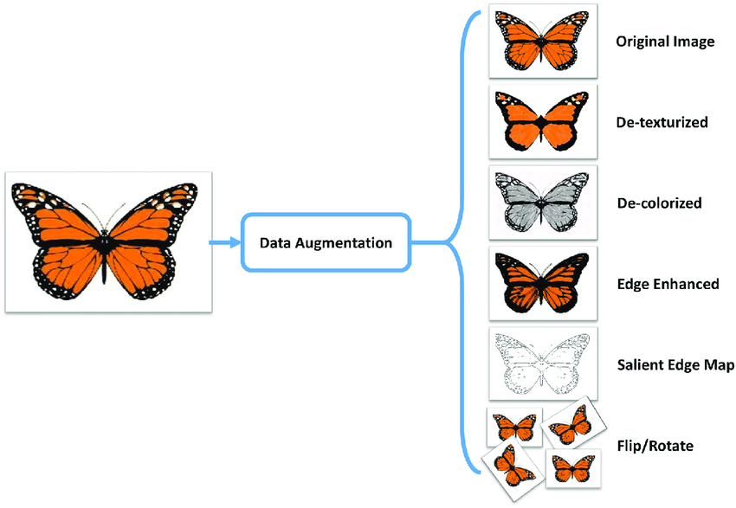
SEMINAR WEB ENGINEERING (WS 2020/2021) DATA AUGMENTATION
What is Data Augmentation?
Data augmentation is a method used in machine learning to expand and enrich a dataset by applying various transformations.
Expand the size of a training set
by creating modified data from
the existing one.
e.g
Rotating, Flipping, Resizing
Adding noise to increase diversity

Slide 4

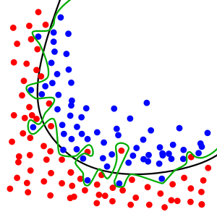

SEMINAR WEB ENGINEERING (WS 2020/2021) DATA AUGMENTATION
Purpose of Data Augmentation
Enlarge dataset
Prevent overfitting
Improve performance model

Slide 5



SEMINAR WEB ENGINEERING (WS 2020/2021) DATA AUGMENTATION
What to Augment!
Audio
Texts
Images
Any other
types

Slide 6
How we can achieve Data Augmentation?
NLP
Synonym replacement
Random insertion/deletion of words
Paraphrasing, and language translation
Audio processing
Background Noise
Pitch Shifting
Computer Vision
Image Flipping
Rotation, Scaling, Resizing, Crop and Pad
Brightness and Contrast Adjustment
Noise Addition, Color Augmentation
Data Mixing

Slide 7
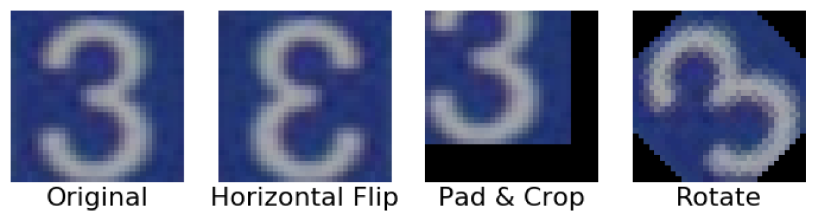
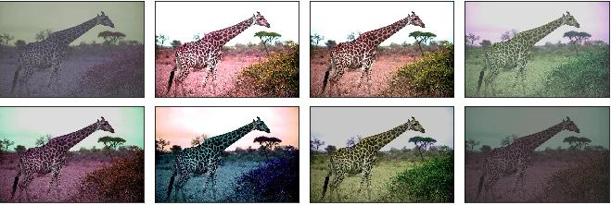

SEMINAR WEB ENGINEERING (WS 2020/2021) DATA AUGMENTATION
Data Augmentation techniques : For Images
Geometric transformations
Color space transformations
Mixing images

Slide 8
SEMINAR WEB ENGINEERING (WS 2020/2021) DATA AUGMENTATION
Data Augmentation techniques : For Text
In my presentation focus topic is Data Augmentation.
In my presentation theme topic is Data Augmentation -- Synonym Replacement
In my presentation focus topic is Data Augmentation techniques -- Random Insertion
In my presentation topic focus is Data Augmentation -- Random Swap
In my presentation focus topic Data Augmentation --Random Deletion

Slide 9
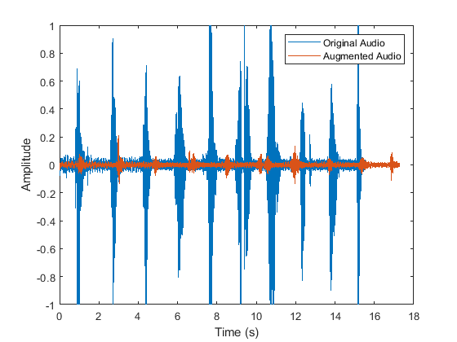
SEMINAR WEB ENGINEERING (WS 2020/2021) DATA AUGMENTATION
Data Augmentation techniques : For Audio
Noise Injection
Shifting
Changing the speed of the Tape

Slide 10



SEMINAR WEB ENGINEERING (WS 2020/2021) DATA AUGMENTATION
Workflow of Data Augmentation
data set
training set
validation set
Data Augmentation
enlarged training set
performance test
and evaluation

Slide 11



SEMINAR WEB ENGINEERING (WS 2020/2021) DATA AUGMENTATION
When do I use data augmentation?
small data set
complex problem
transformation of data would be effective and easy
You know how to find the correct method for your data
You have a strategy for dealing with overfitting

Slide 12

SEMINAR WEB ENGINEERING (WS 2020/2021) DATA AUGMENTATION
Data Augmentation Applications
Natural Language Processing
Image classification
Speech recognition, sound classification
text classification, text generation
Scientific research, medical fields
Human-computer interaction, Understanding human emotion

Slide 13


SEMINAR WEB ENGINEERING (WS 2020/2021) DATA AUGMENTATION
demo
Natural Language Processing: some tasks
Translation tasks
Speech emotion recognition
Text generation, dialogue management
Text classification
syntax and semtantic analysis
Speech recognition
Text-to-speech

Slide 14
SEMINAR WEB ENGINEERING (WS 2020/2021) DATA AUGMENTATION
NLP and Data augmentation in speech emotion recognition
C. Etienne and B. Schmauch, "Speech Emotion Recognition with Data Augmentation and Layer-wise Learning Rate Adjustment”
Problem:
class imbalance and small dataset
Solution:
Data augmentation by rescaling of spectograms
Results:
Improvement in accuracy of predictions
 | Baseline |  |  | Best model
Augmentation during training | - | - | + | +
Oversampling (×2) of happiness and anger | - | + | + | +
Frequency range (kHz) | 4 | 4 | 4 | 8
Weighted accuracy | 66.4 | 63.5 | 64.2 | 64.5
Unweighted accuracy | 57.7 | 59.8 | 60.9 | 61.7
10-cross validation scores depending on the techniques applied (for each experiment we present the results corresponding to its best run).

Slide 15
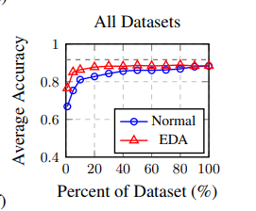
SEMINAR WEB ENGINEERING (WS 2020/2021) DATA AUGMENTATION
NLP and Data augmentation in classification tasks
J. Wei and K. Zou, "EDA: Easy Data Augmentation Techniques for Boosting Performance on Text Classification Tasks”
Problem: Performing text classification depends on quality and quantity of data
Solution: Data augmentation by application of multiple transformations on text
Results: Performance gain of model if right amount of data augmentation chosen
Performance on benchmark text classification tasks with and without EDA, for various dataset sizes used for training. [1]

Slide 16



SEMINAR WEB ENGINEERING (WS 2020/2021) DATA AUGMENTATION
Demo: NLP text classification and Data Augmentation
dataset of movie reviews
Create a model with scikitlearn
Process the data
Split the data into test and training set
Data Augmentation with nlpaug
Apply classifier: RandomForestClassifier
Evaluate the model
positive
negative

Slide 17
SEMINAR WEB ENGINEERING (WS 2020/2021) DATA AUGMENTATION
Demo: Result of Augmentation with synonym replacement
original review
augmented review
a sci fi/comedy starring jack nicholson , pierce brosnan , annette benning , glenn close , martin short and other stars.
a warner bros picture
the martians have landed in this hillarous tim burton movie.
before entering the cinema , i was initially a little bit nervous about what this film would be like .
many people were saying that this film was silly rubbish , and there was no point to it all .
how wrong they were .
i left this film feeling much happier than i was before i entered the cinema .
the story is about martians attacking earth .
using ray guns ( hooray ! )
they generally cause havoc around the u . s and other countries.
a sci fi / funniness star knave nicholson, president pierce brosnan, annette benning, john herschel glenn jr. close, dino paul crocetti short and other stars.
a charles dudley warner bros picture
the martians hold landed in this hillarous tim burton motion picture. before entering the movie theater, i was ab initio a little bit nervous about what this plastic film would comprise similar.
many people were saying that this film be silly rubbish, and at that place was no point to it all. how wrong they were.
i left this motion picture show feeling much happier than i was before single entered the cinema.
the chronicle is about martians attacking worldly concern.
using shaft of light gun (hooray! )
they generally cause havoc around the u. due south and other state.

Slide 18
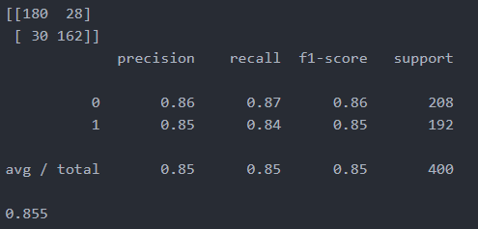


SEMINAR WEB ENGINEERING (WS 2020/2021) DATA AUGMENTATION
Demo: Results and Discussion
performed text classification with an 85% accuracy
augmented over 2000 text files
improved the model with augmentation
accuracy of the predictions of the text classifier without augmentation

Slide 19




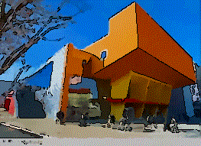

SEMINAR WEB ENGINEERING (WS 2020/2021) DATA AUGMENTATION
Demo: BONUS - image augmentation with imgaug
Augmentation by: cropping, scaling, artistic filters, weather, blur, rotation, flip...

Slide 20
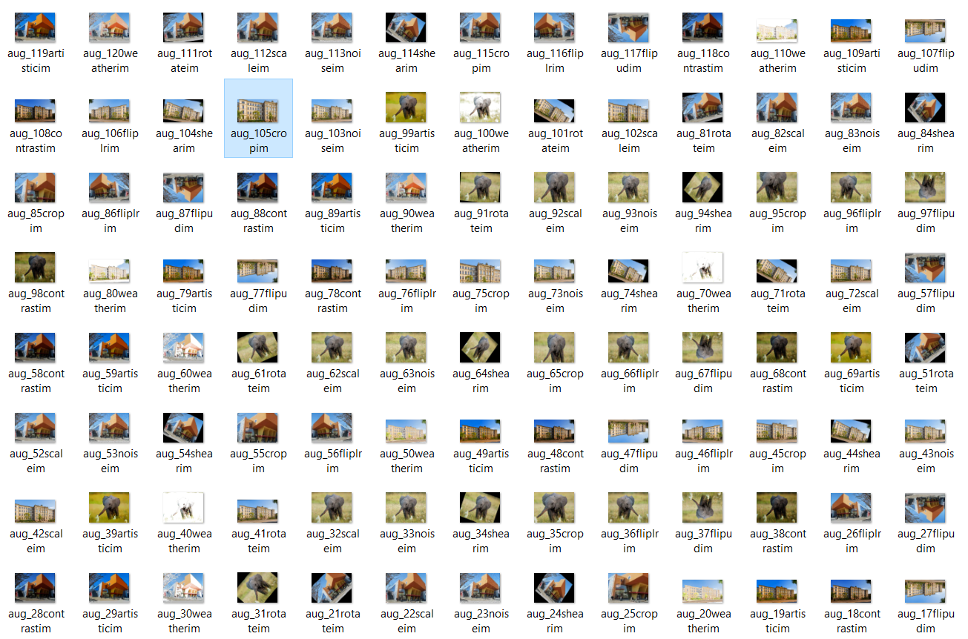
SEMINAR WEB ENGINEERING (WS 2020/2021) DATA AUGMENTATION
Demo: BONUS - image augmentation with imgaug
120
images
180
seconds

Slide 21
SEMINAR WEB ENGINEERING (WS 2020/2021) DATA AUGMENTATION
Data augmentation: pros and cons
+ | -
easy implementation, low effort | time consuming (sometimes)
tailored approach, no model changes | trial and error
performance boost: easy to measure | relational gaps between data and augmented data
can help with overfitting | can lead to overfitting if not done right

Slide 22


SEMINAR WEB ENGINEERING (WS 2020/2021) DATA AUGMENTATION
Data augmentation: key takeaway
small data set
Data Augmentation
enlarged data set
model

Slide 23
Thank you all

